Slide 1
Your Brain, On Programming
Angela May O’Connor
Lambda Conf 2017

Slide 2
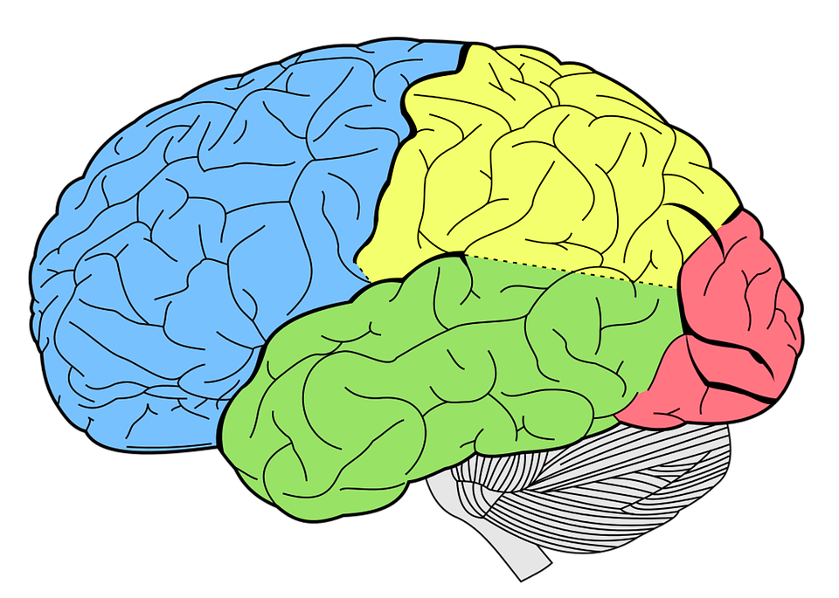
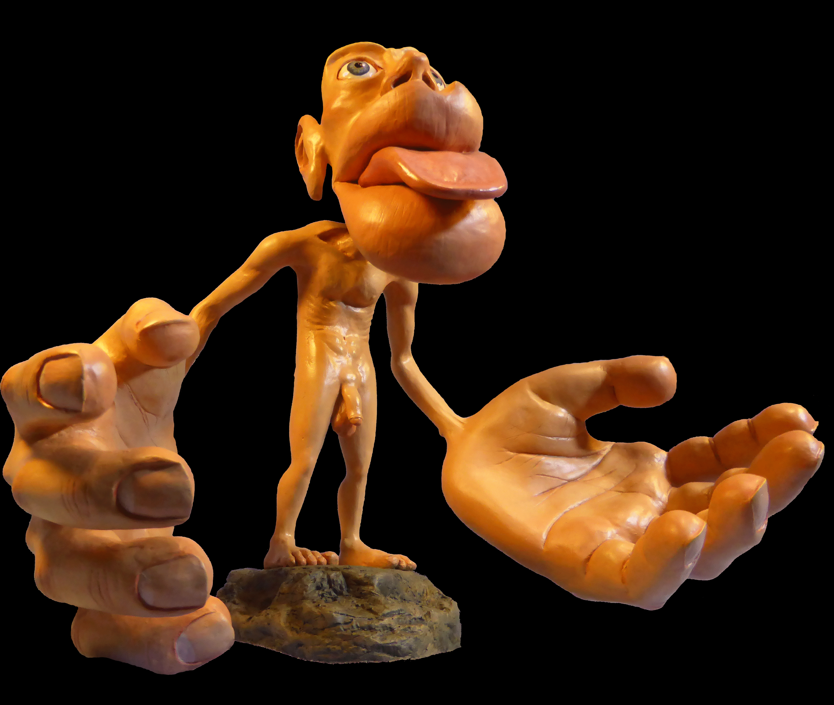
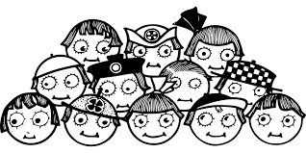
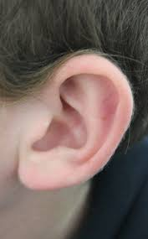
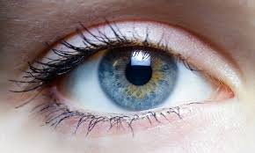


Localised specialisation
Frontal Lobe
Parietal Lobe
Occipital Lobe
Cerebellum
Temporal Lobe
Brainstem

Slide 3

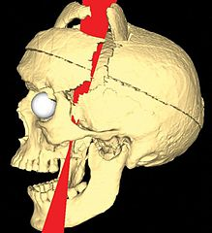
How do we know this – case studies!
Phineas Gage:
Iron rod blasted through his frontal lobe
Subsequent “reckless” behaviour, less self control
Recommended reading: “The Duelling Neurosurgeons”

Slide 4
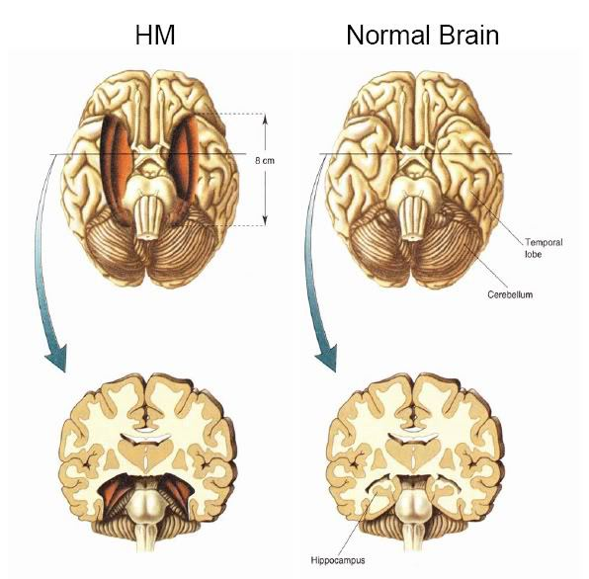
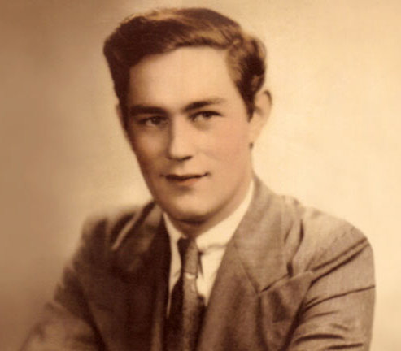
How do we know this – case studies!
“HM”:
Surgical removal of hippocampus
Subsequent loss of ability to form memories
Recommended reading: “The Duelling Neurosurgeons”

Slide 5
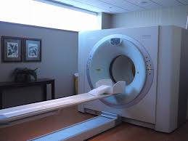
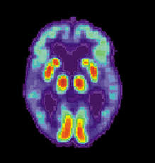
Localised specialization – what brain regions are used for programming and how can we determine this?
fMRI machines – large magnets that spin around your head
Produce images measuring movement of oxygenated blood in response to tasks or stimuli
Notes:
Lesion and injury case studies are useful for determining gross function, but not so much for dissection of complex tasks
Functional Magnetic Resonance Imaging (fMRI) allows us to study brain activity in real-time without damaging tissue

Slide 6
Localised specialization – what brain regions are used for programming and how can we determine this?
Siegmund et al 2014 – fMRI on programmers within an fMRI machine:
Snippets of code that were pre-tested for difficulty and time to solve
Two types of tasks – comprehension and syntactical
Minimal motor output in response to tasks
Post-testing to determine whether participants actually understood the code

Slide 7
Localised specialization – what brain regions are used for programming and how can we determine this?
Comprehension tasks:
Solvable in 30 – 120 seconds
JAVA
No recursion
Designed to induce bottom-up rather than top-down comprehension
Minimisation of other cognitive tasks unrelated to programming

Slide 8
Localised specialization – what brain regions are used for programming and how can we determine this?
Syntax tasks:
Identical to comprehension tasks except for three errors
Errors able to be picked up in 30 – 120 seconds
Designed to induce pattern-matching without needing to understand what the code does

Slide 9
What parts of the brain were activated during comprehension programming tasks?
Activation during comprehension tasks was compared to that during syntax tasks; divided into two categories:
Working memory and divided attention (Brodmann’s areas 6 and 40)
Language processing (Brodmanns areas 47, 44, and 21)
Therefore understanding code requires problem solving skills and ability to process language
tinyurl.com/ProgramComprehensionAndfMRI/

Slide 10
What parts of the brain were activated during comprehension programming tasks?
Brodmann’s areas 6 and 40:
Division of attention
Silent word reading
Verbal/Numerical working memory
Problem solving

Slide 11
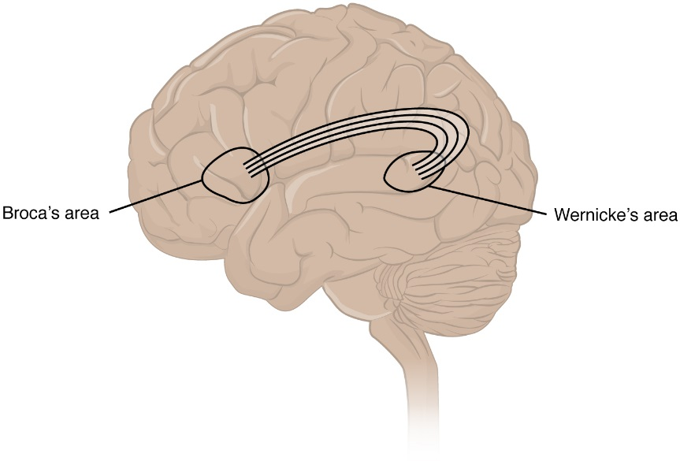
What parts of the brain were activated during comprehension programming tasks?
Brodmann’s areas 21, 44 and 47:
Semantic processing of individual words (BA21)
BA21 constitutes part of Wernicke’s area, which is involved in speech comprehension
Processing of complex grammar and semantic tasks (BA44 and BA 47)
BA44 constitutes part of Broca’s area, which is involved in the production of language

Slide 12
In summary:
Many regions of the brain and associated skillsets are used during programming
Attention ability
Reading
Working memory
Problem solving
Language processing
Is there any way we can train ourselves to become better at any of these tasks?

Slide 13
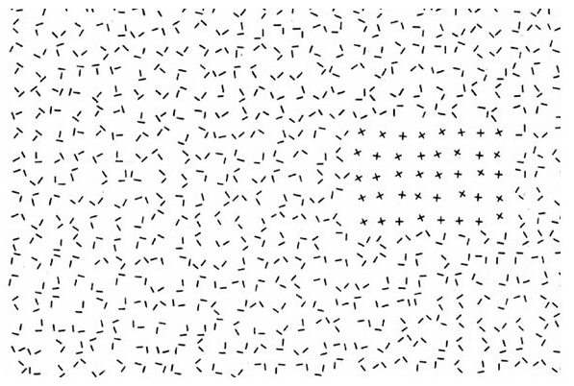
What is attention?
Attention:
“Selection” of objects within the visual field -> preattentive scanning and focal attention
Julesz and Bergen 1983

Slide 14

What is attention?
Attention:
Directed to both and object and its location within the visual field -> competition for visual processing capacity!
“Spotlight” of attention
https://www.youtube.com/watch?v=vJG698U2Mvo

Slide 15
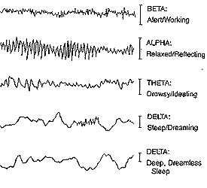
Different brain waves indicate particular states of consciousness
Beta waves are most important for attention to tasks
Image: Ned Herrmann, The Creative Brain

Slide 16
Training your attention
Learned self-regulation: viewing brain activity in real-time (EEG/fMRI) as you perform a task allows you to better regulate brain activity
Divided attention task attending to tones (high in left, low in right)
TOVA test: inattentiveness and impulsivity
https://www.youtube.com/watch?v=UHaQ3nx8ZJg
Neurofeedback via EEG used for subjects to enhance particular brain waves (beta1 15 – 18Hz and sensorimotor rhythm 12 – 15Hz)

Slide 17
Training your attention
Subjects with sensorimotor EEG feedback training had fewer false alarms (d’ score) and fewer omission errors on the divided attention task attending to tones
Subjects with beta1 EEG feedback had faster reaction times on the TOVA task
Awareness of brain activity improved performance in attention tasks!

Slide 18
What is working memory?
Working memory:
Temporary storing of information used to guide future actions
Form of motor planning -> active maintenance of information relevant to an ongoing behavior
Integration of moment-to-moment perception with already-known information

Slide 19
Training your working memory
Conceptual span task combined with neurofeedback via EEG for enhancing sensorimotor signal (12 – 15Hz)
https://www.youtube.com/watch?v=Ztl6lclnkxg&t=104s
Conceptual span task:
cat
arm
Australia
Countries
dog
leg
Indonesia
horse
teeth
Vietnam
Animals
mouse
heart
Uganda
Body parts

Slide 20
Training your working memory
Subjects trained to increase sensorimotor waves had fewer errors and higher correct recall

Slide 21
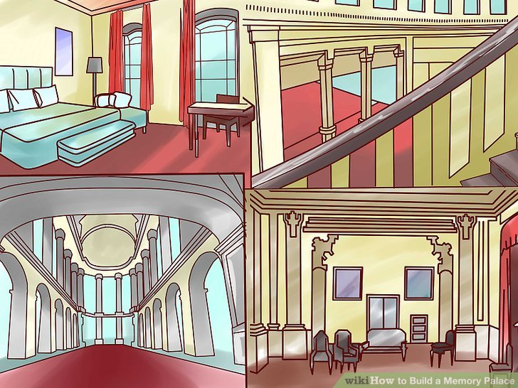
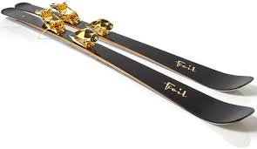



Training your working memory
However! Not all of us have access to an EEG or fMRI apparatus
Other methods for improving working memory:
Dominic system and Major system
Memory palaces
http://www.newyorker.com/news/sporting-scene/lessons-from-americas-first-memory-world-champion
Notes:
Dominic and Major system– convert numerical digits into letters or sounds and use them to tell a story that helps you to remember large number sequences, memorise decks of cards
Memory palaces: Cat
Skis
Garden
Eyes

Slide 22
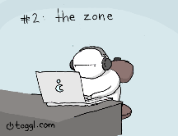
Problem Solving: What is flow state?
Flow state:
Fully focused, absorbed in, and enjoying what you are doing
Also known as “in the zone”
https://blog.toggl.com/2014/12/programmer-problems-comic/

Slide 23
Different brain waves indicate particular states of consciousness
Theta waves are most important for flow state:
theta is related to increases in attention, workload, memory load, and working memory performance
Image: Ned Herrmann, The Creative Brain

Slide 24
How to train your brain to enter “flow” state more easily?
(or, to problem solve with less difficulty!)
EEG (electroencephalogram) technology is getting cheaper and more accessible
Monitoring brain waves – determine state of optimal flow
EEG + software – train brain to more easily enter flow
http://www.wearablesensing.com/news.php
https://www.youtube.com/watch?v=hLjxMjBlB9k
http://brain.ieee.org/

Slide 25
How to train your brain to enter “flow” state more easily?
(or, to problem solve with less difficulty!)
Better-designed training materials:
Guided questioning produces better problem solving skills than being left to figure it out alone
(Effects of training in strategic questioning on children's problem-solving performance King, Alison Journal of Educational Psychology, Vol 83(3), Sep 1991, 307-317)
Explicit training in problem-solving strategies
(Training in Self-Explanation and Self-Regulation Strategies: Investigating the Effects of Knowledge Acquisition Activities on Problem Solving Katerine Bielaczyc , Peter L. Pirolli & Ann L. Brown Pages 221-252)
Lots of practice!
Notes:
Example of driving and being in the zone/unaware -> because you do it lots!

Slide 26
Summary/Conclusions
Many regions of the brain and associated skillsets are used during programming
We can work on improving the skills involved in programming

Slide 27
Language processing
Many parts of the brain are involved in language processing:
Broca’s -> production of language
Wernicke’s -> comprehension of language
Various other areas -> implementation system, mediational system, conceptual system

Slide 28
How to become better at processing languages?
Look at how “natural” languages are processed:
- Monolingual vs multilingual individuals have differential brain activity
Learning programming languages is analogous to learning other “natural” languages
New semantic information can be easily acquired throughout life!
Notes:
Approach learning a programming language in the same way that we learn natural languages? Repetition, immersion?

Slide 29
Summary/Conclusions
Many regions of the brain and associated skillsets are used during programming
We can work on improving the skills involved in programming
Programming is like learning to use a new language and solving problems in that language

Slide 30

Hacking the brain’s natural abilities to create new methods of programming?
Paradolia!

Slide 31
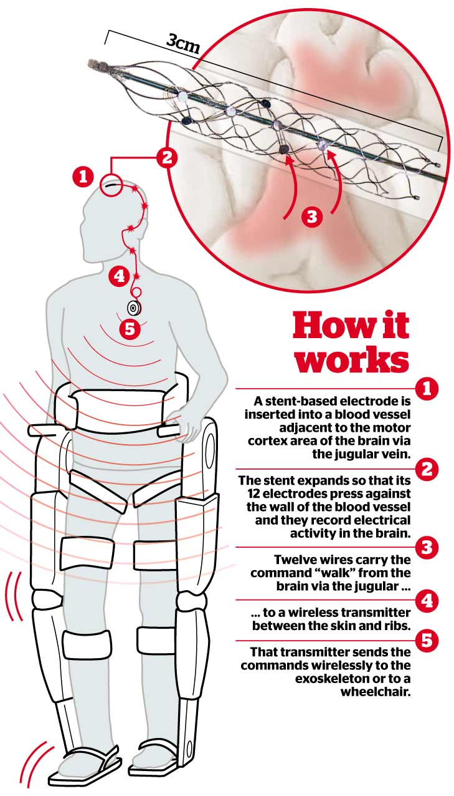
Programming for good: role of computers and programming in bio treatments
Computers can be used to help in therapies in ways currently unimaginable
Current clinical trial for paraplegia: robot legs and transmitter in brain

Slide 32
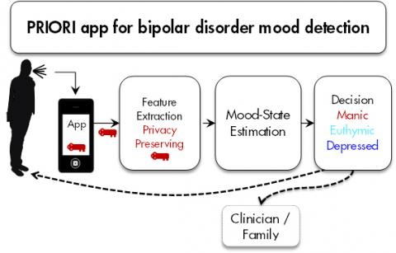
Programming for good: role of computers and programming in bio treatments
Computers can be used to help in therapies in ways currently unimaginable
Current clinical trial for tracking mental health: voice patterns indicate manic or depressive episode
http://research.umich.edu/news-issues/michigan-research/sum-your-parts

Slide 33
Video games for healing
Mood disorders are prevalent (1 in 5) and costly (approx. 80 billion a year) – video games are an effective and readily available treatment option

Slide 34
Video games for healing
Post Traumatic Stress Disorder – occurs when stress reaction to a stimulus becomes generalized
Exposure therapy is used during treatment, but is time-consuming and costly -> video games can help!

Slide 35
Summary/Conclusions
Many regions of the brain and associated skillsets are used during programming
We can work on improving the skills involved in programming
Programming is like learning to use a new language and solving problems in that language
We can also improve programming itself to take advantage of the abilities of our wetware
There is a big future for programming and computer aided therapies in medical treatment

Slide 36
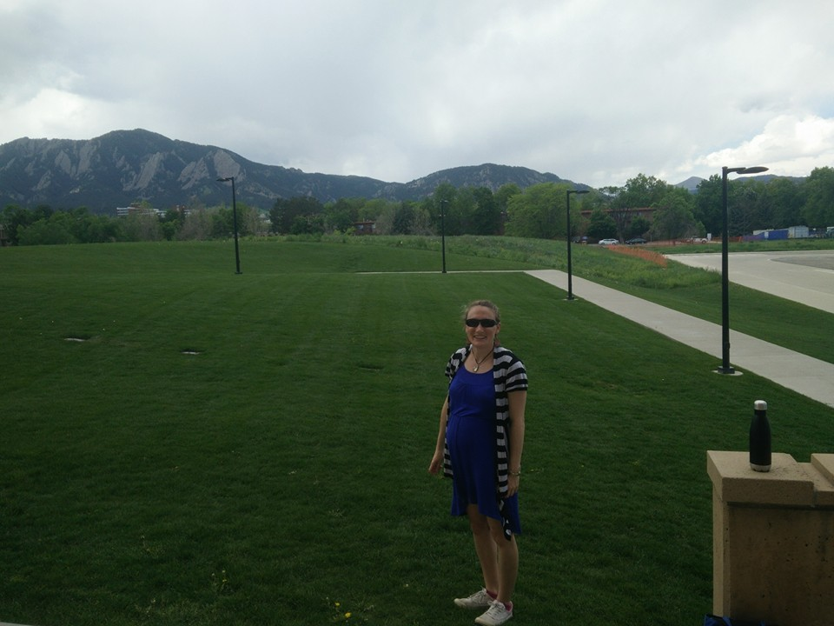





Thank you!
@amayoco

Slide 37


Currently looking for a Research Fellow:
Analysis of gene expression data for neuropsychiatric illnesses
Statistics and programming
http://careers.umich.edu/job_detail/141256/research_fellow

